Slide 1
Amazon Product Recommender System
CS550 Final Project
Aishwarya Harpale - ach149
Vaishnavi Manthena - vm504

Slide 2
Overview
The goal of this project is to build a recommendation system for the digital music domain. The key component of this project is to predict the rating a user might give to an item in the digital music domain based on a given amazon dataset of known user to item interactions. Making smart predictions is consequential for accurate recommendations and user-friendliness of an e-commerce website.
We use several algorithms to form prediction models. We evaluate each prediction model and corresponding recommendations to understand which algorithms are best and appropriate to combine and form improvised hybrid models.

Slide 3
Dataset and Preprocessing
We used the Digital Music subset of the Amazon Review Dataset for our project.
It consists of 169,781 records and 12 columns. For preprocessing the following steps were performed.
Removing columns that had >80% empty values.
Removing records that had empty values.
Renaming columns to better represent the data.
The final shape of data was - 169,606 records with 9 columns.

Slide 4
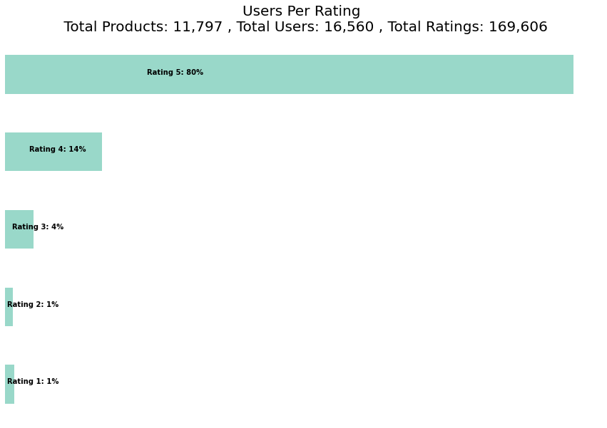
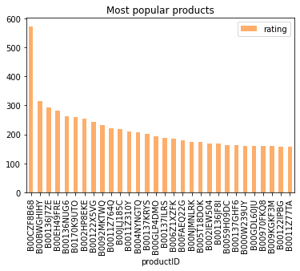
Exploratory Data Analysis

Slide 5
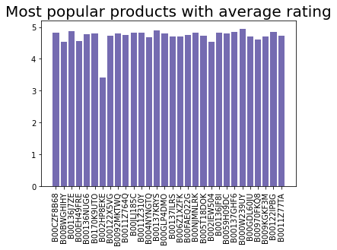
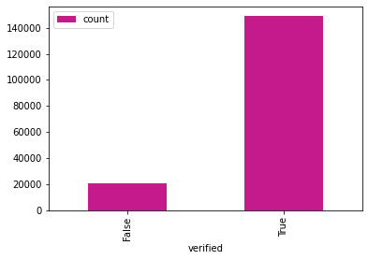
EDA (cont.)
Number of verified users

Slide 6
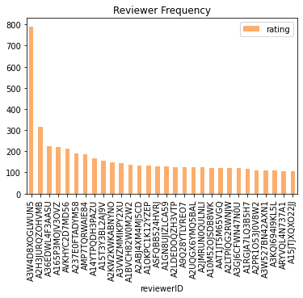
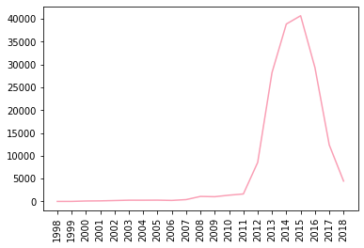
EDA (cont.)
Number of reviews per year

Slide 7
Algorithms
Memory Based Methods
Item-Item
User-User
Model Based Methods
KNN
User-based similarity
Item-based similarity
SVD
NMF

Slide 8
Algorithm - KNN (K Nearest Neighbors)
KNN works as a nearest neighbors algorithm based on similarity values between items. The similarities calculated based on the user or the items.
The similarity measures are learned from training data.
KNN
User
Item
Cosine Similarity
Mean Squared Difference
Cosine Similarity
Mean Squared Difference

Slide 9
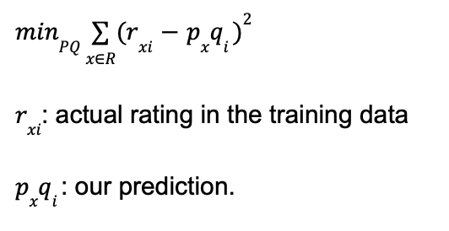
Algorithm - SVD (Singular Value Decomposition)
The utility matrix (rows: users, columns: items, entries: ratings) is predicted to be the matrix product PQ^{T}. The entries of the P and Q matrix are learned by trying to minimize the rmse value. This is the clear basic minimization problem:

Slide 10
Algorithm - NMF (Non-Negative Matrix Factorization)
Learning Algorithm to extract hidden semantics from the data.
Factorization: V = W*H
(user * item) = (user * topic) * (topic * item)
The W, H matrices are initially guesses. Iteratively update W*H to minimize a loss function. Continue ensuring that the entries of W, H matrices are non-negative. Stop when the W, H matrices are stable enough. W*H now forms a good estimate for the ratings.

Slide 11
Algorithm - Memory Based Models (Collaborative Filtering)
User Based Collaborative Filtering
To predict the rating by user ‘x’ on item ‘i’ consider the similarity of other users to user ‘x’ using the cosine similarity. Now take the weighted average (based on user-user similarity) of the ratings given by other users to item ‘i,’ and use this as the prediction.
Item Based Collaborative Filtering
To predict the rating by user ‘x’ on item ‘i’ consider the similarity of other items to item ‘i’ using the cosine similarity. Now take the weighted average (based on item-item similarity) of the ratings given by user ‘x’ to other items and use this as the prediction.
Since we do not learn any parameters here, we did not use cross validation
in this one case.

Slide 12
Results - KNN
ALGORITHM | MAE | RMSE | PRECISION | RECALL | F MEASURE | NDCG
User-based(MSD) | 0.4310 | 0.7353 | 0.9386 | 0.9494 | 0.9440 | 0.8385
User-based(Cosine similarity) | 0.4755 | 0.7799 | 0.9356 | 0.9457 | 0.9406 | 0.8386
Item-based(MSD) | 0.3397 | 0.6215 | 0.9400 | 0.9522 | 0.9461 | 0.8451
Item-based(Cosine Similarity) | 0.3561 | 0.6419 | 0.9366 | 0.9494 | 0.9430 | 0.8445

Slide 13
Results
ALGORITHM | MAE | RMSE | PRECISION | RECALL | F MEASURE | NDCG
SVD | 0.3577 | 0.5847 | 0.9420 | 0.9620 | 0.9519 | 0.8271
NMF | 0.5877 | 0.7798 | 0.9023 | 0.8876 | 0.8949 | 0.8242
Item-based CF | 4.673 | 4.728 | 0.0083 | 0.0147 | 0.01058 | 0.0358
User-based CF | 4.692 | 4.745 | 0.0252 | 0.0440 | 0.0321 | 0.1306

Slide 14
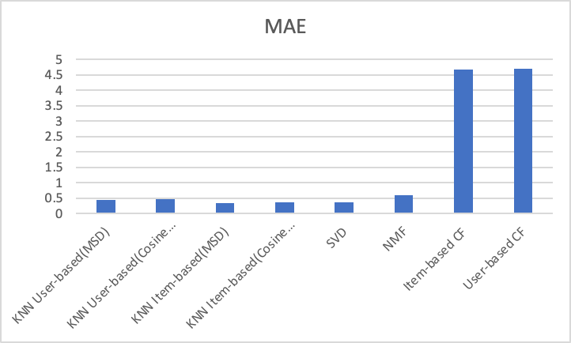
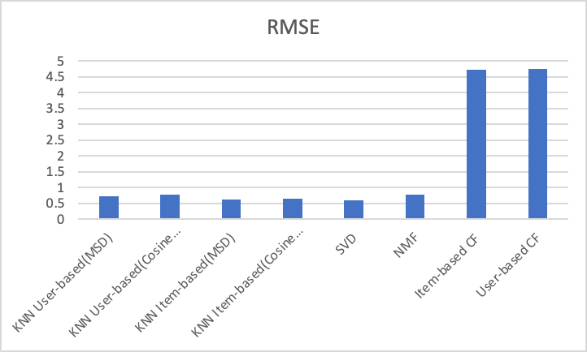
Results (Graph)

Slide 15
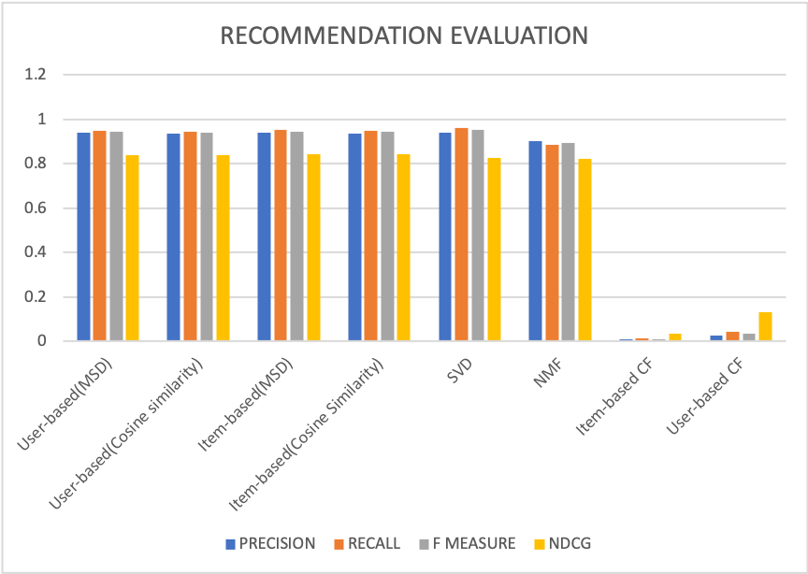
Results

Slide 16
Future Scope
Creating embeddings for the review text and summary. Possible choices are Bag of Words, GloVE, BERT etc.
Deep Learning based models for recommendation.
Implementing a hybrid model which includes the best performing models.

Slide 17
Thank you

